Slide 1
Teaching Disciples: Part 1
2024 Quarter 3 Lesson 07
Mark 8, 9

Slide 2
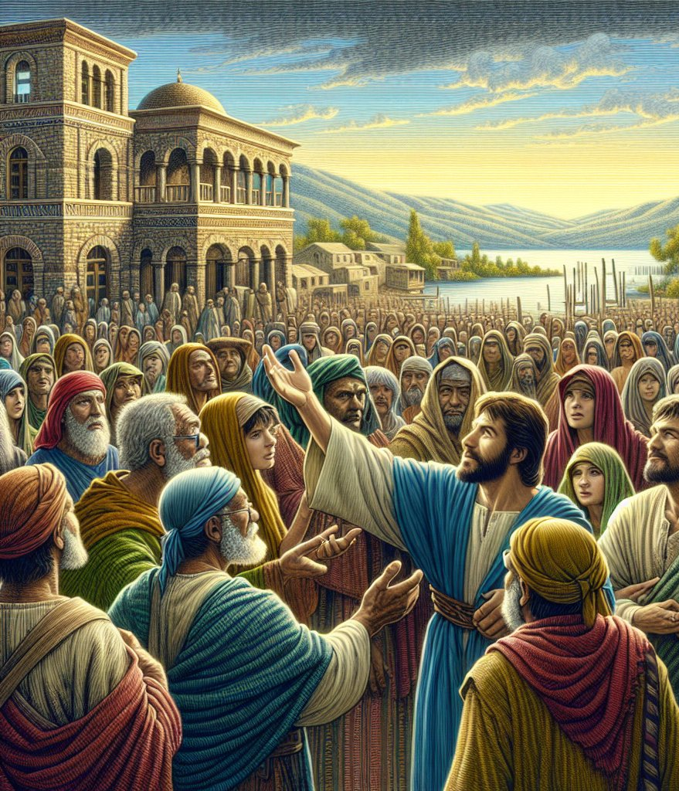
A Blind Man in Bethsaida
Mark 8:22-26
22 And he cometh to Bethsaida; and they bring a blind man unto him, and besought him to touch him.

Slide 3
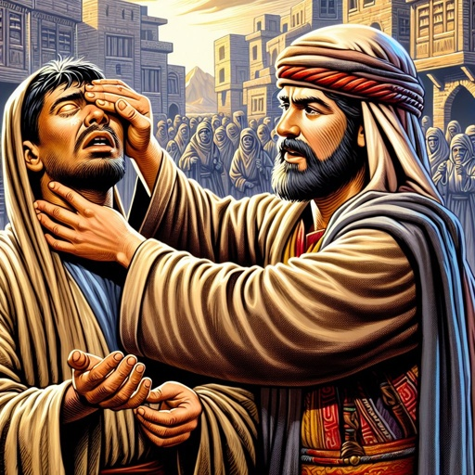
A Blind Man in Bethsaida
Mark 8:23-26
23 And he took the blind man by the hand, and led him out of the town; and when he had spit on his eyes, and put his hands upon him, he asked him if he saw ought.

Slide 4
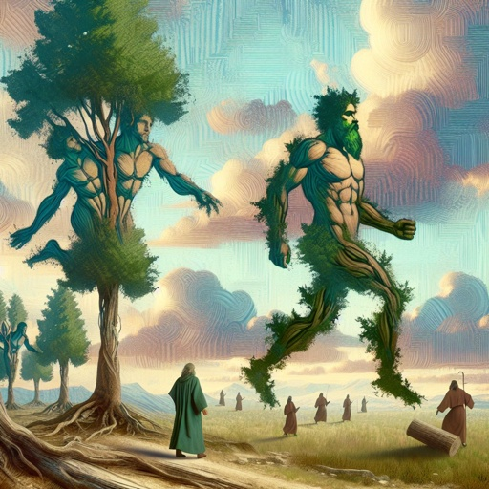
A Blind Man in Bethsaida
Mark 8:24-26
24 And he looked up, and said, I see men as trees, walking.
25 After that he put his hands again upon his eyes, and made him look up: and he was restored, and saw every man clearly.

Slide 5
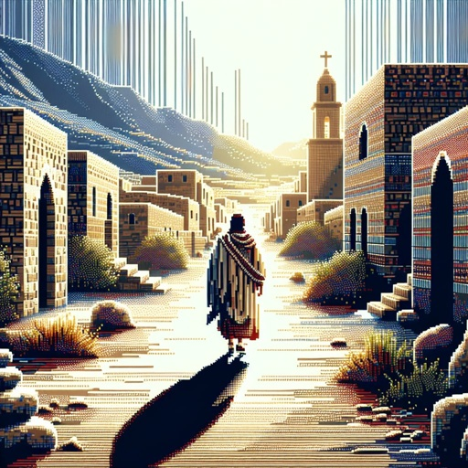
A Blind Man in Bethsaida
Mark 8:26
26 And he sent him away to his house, saying, Neither go into the town, nor tell it to any in the town.

Slide 6
A TWO-STEP MIRACLE?
Be not afraid, only believe.
Mark 5:36
And he said unto her, Daughter, thy faith hath made thee whole;
Mark 5:34
And he said unto her, For this saying go thy way; the devil is gone out of thy daughter. Mark 7:29
Jesus said unto him, If thou canst believe, all things are possible to him that believeth. Mark 9:23
52 And Jesus said unto him, Go thy way; thy faith hath made thee whole.
Mark 10:52

Slide 7
A TWO-STEP MIRACLE?
SDABC on Mark 8:24
This is the only recorded instance in which Jesus performed a cure in two stages. There is no apparent reason for the use of this method in this case. However, it should be noted that, as partial vision was restored to the man, his faith increased and he was ready to believe that Jesus could cure him completely.

Slide 8
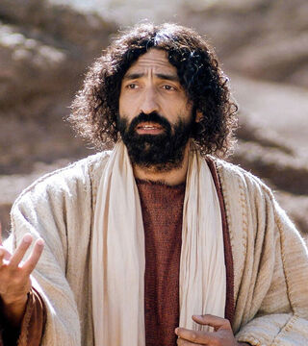
A Saving Faith
Mark 8:27-33
27 And Jesus went out, and his disciples, into the towns of Caesarea Philippi: and by the way he asked his disciples, saying unto them, Whom do men say that I am?

Slide 9
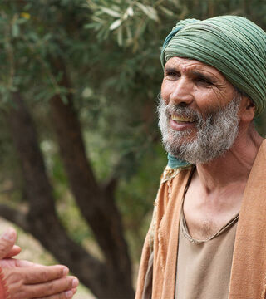
A Saving Faith
Mark 8:28-33
28 And they answered, John the Baptist; but some say, Elias; and others, One of the prophets.

Slide 10
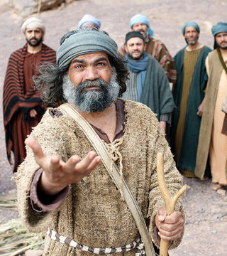
A Saving Faith
Mark 8:29-33
29 And he saith unto them, But whom say ye that I am? And Peter answereth and saith unto him, Thou art the Christ.

Slide 11
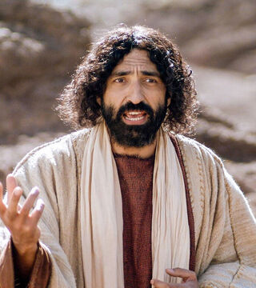
A Saving Faith
Mark 8:30-33
30 And he charged them that they should tell no man of him.

Slide 12
SDABC on Matthew 16:15
“
“Constant companions of Jesus now for more than a year, and some of them for more than two years, the disciples had had opportunities to observe the many evidences of the divinity of Jesus far exceeding those of other men. Now Jesus gave them an opportunity to testify to their faith.”
”

Slide 13
SDABC on Matthew 16:15
“
“Though their understanding of Him was even yet far from perfect, Andrew, Philip, and Nathanael had apparently believed from the very beginning that Jesus was the Messiah. After the storm on the lake all the disciples had worshiped Him, and after the crisis in Galilee they had professed faith in Him as the Son of God.”
”

Slide 14
SDABC on Matthew 16:16
“
“The disciples were still loyal to Christ as the Messiah of prophecy, even though they understood but imperfectly all that was involved in it. Later, of course, they did understand. Except as they grasped this fundamental truth by faith and held firmly to it, they too would fail utterly to grasp the truth that the Messiah must suffer.”
”

Slide 15
SDABC on Matthew 16:16
“
“As it was, when His hour of extremity came, “all the disciples forsook him, and fled.” Even so, Jesus was basing the future hopes of the church on this little band of witnesses, and unless they believed Him to be the Christ, what hope was there that other men would ever believe this sublime truth?”
”

Slide 16
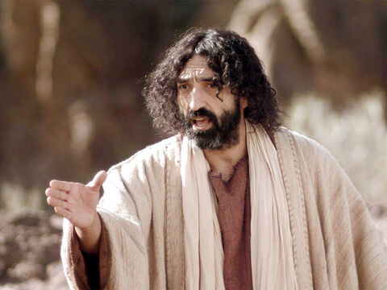
A Saving Faith
Mark 8:31-33
31 And he began to teach them, that the Son of man must suffer many things, and be rejected of the elders, and of the chief priests, and scribes, and be killed, and after three days rise again.

Slide 17
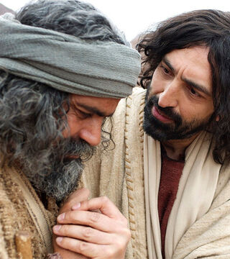
A Saving Faith
Mark 8:32-33
32 And he spake that saying openly. And Peter took him, and began to rebuke him.

Slide 18
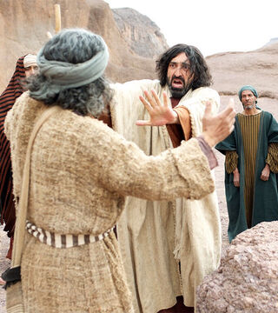
A Saving Faith
Mark 8:33
33 But when he had turned about and looked on his disciples, he rebuked Peter, saying, Get thee behind me, Satan: for thou savourest not the things that be of God, but the things that be of men.

Slide 19
“After Peter's confession, Jesus charged the disciples to tell no man that He was the Christ. This charge was given because of the determined opposition of the scribes and Pharisees.”
The Desire of Ages p.414

Slide 20
“More than this, the people, and even the disciples, had so false a conception of the Messiah that a public announcement of Him would give them no true idea of His character or His work.”
The Desire of Ages p.414

Slide 21
“But day by day He was revealing Himself to them as the Saviour, and thus He desired to give them a true conception of Him as the Messiah.”
The Desire of Ages p.414

Slide 22
“The disciples still expected Christ to reign as a temporal prince. Although He had so long concealed His design, they believed that He would not always remain in poverty and obscurity; the time was near when He would establish His kingdom.”
The Desire of Ages p.415

Slide 23
“That the hatred of the priests and rabbis would never be overcome, that Christ would be rejected by His own nation, condemned as a deceiver, and crucified as a malefactor,—such a thought the disciples had never entertained.”
The Desire of Ages p.415

Slide 24
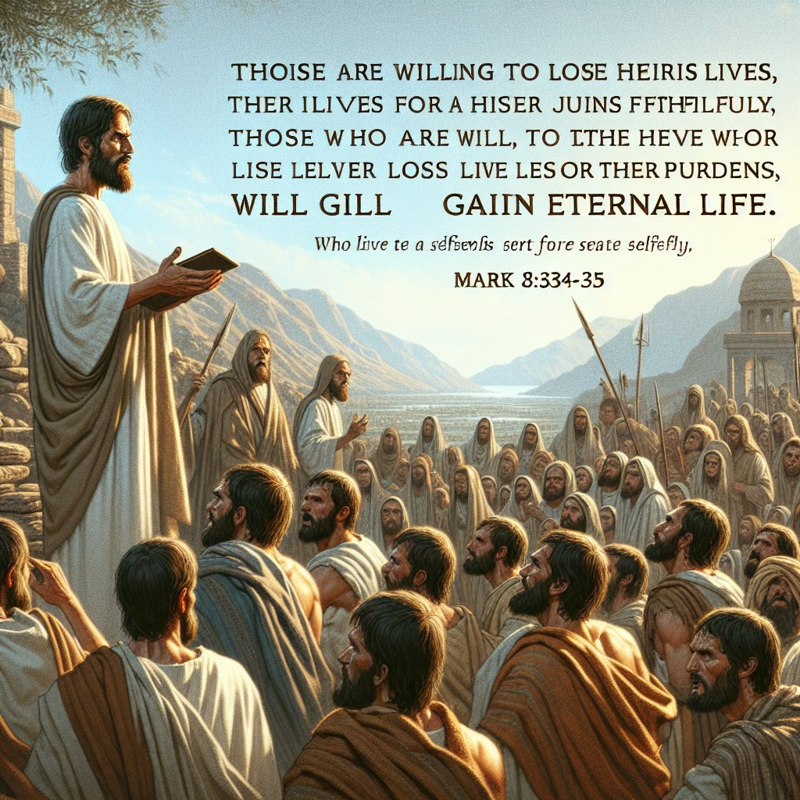
Faith in ACTION
Mark 8:34-38
34 And when he had called the people unto him with his disciples also, he said unto them, Whosoever will come after me, let him deny himself, and take up his cross, and follow me.

Slide 25
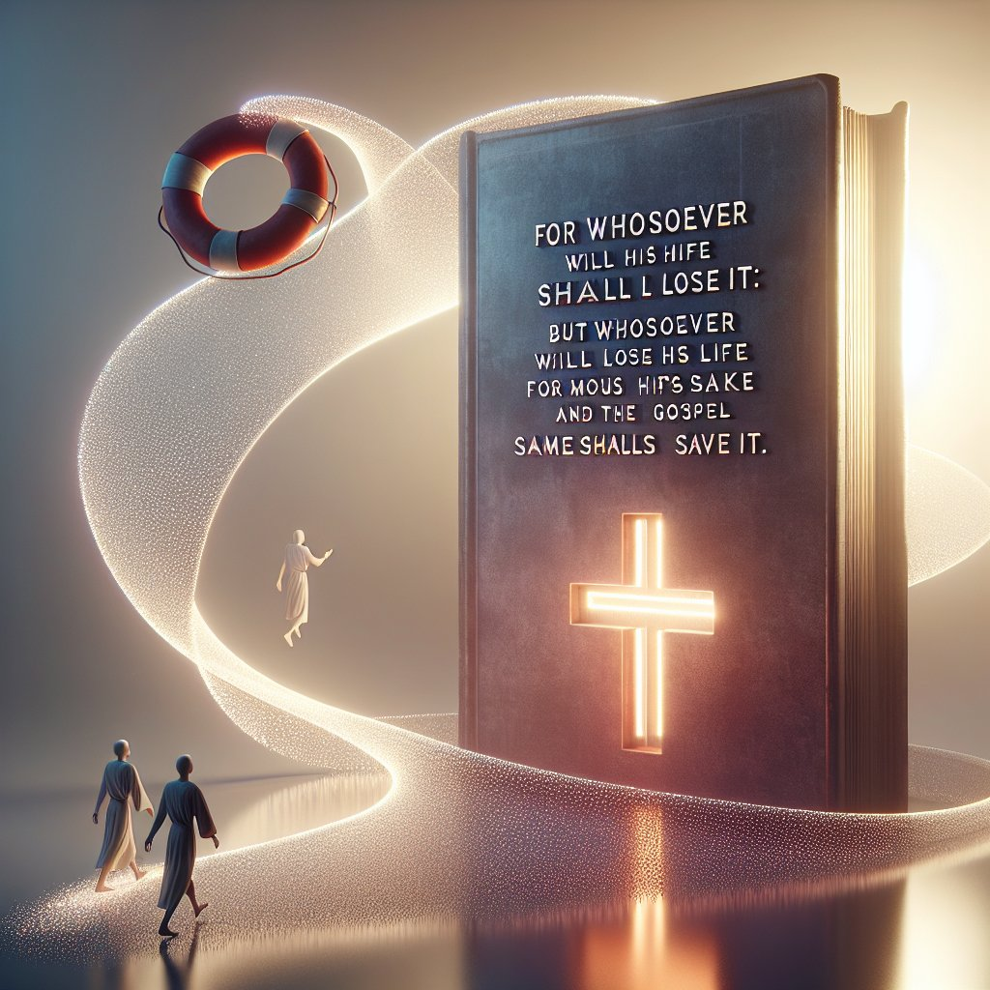
Faith in ACTION
Mark 8:35-38
35 For whosoever will save his life shall lose it; but whosoever shall lose his life for my sake and the gospel's, the same shall save it.

Slide 26

Faith in ACTION
Mark 8:36-38
36 For what shall it profit a man, if he shall gain the whole world, and lose his own soul?
37 Or what shall a man give in exchange for his soul?

Slide 27
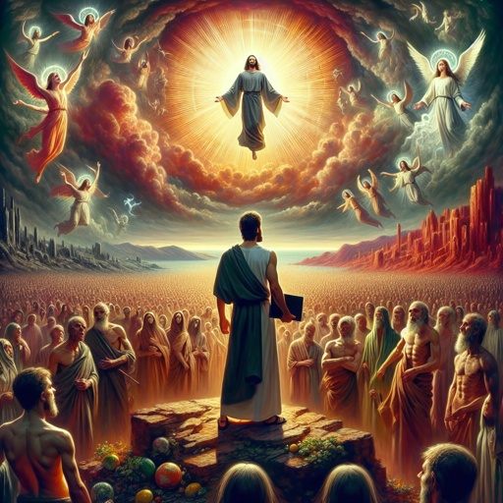
Faith in ACTION
Mark 8:38
38 Whosoever therefore shall be ashamed of me and of my words in this adulterous and sinful generation; of him also shall the Son of man be ashamed, when he cometh in the glory of his Father with the holy angels.

Slide 28
SDABC on Matthew 16:24
“
“A criminal condemned to die by crucifixion literally did “take up his cross.” In the context in which Christ here mentions cross bearing, it seems that He refers, not so much to the minor difficulties and obstacles to be encountered by disciples, but rather to the need of being ready to face death itself.”
”

Slide 29
SDABC on Matthew 16:24
“
“Peter had just attempted to persuade Jesus to abandon the divine plan that called Him to take up His cross. Jesus replies that this is impossible, for such is not the will of the Father, and that, furthermore, if Peter is to continue as a disciple he must be willing to pay the same price, as, indeed, he eventually did.”
”

Slide 30
SDABC on Matthew 16:24
“
“Elsewhere Christ presented the additional thought that disciples must take up their crosses “daily,” in consecration to the life of service to which they are called. If men hated Jesus, they might also be expected to hate His representatives, the disciples.”
”

Slide 31
SDABC on Matthew 16:24
“
“The would-be disciple must first renounce himself, his own plans, his own desires; then he must be willing to bear any cross that duty calls him to “take up;” finally, he must “follow” in the footsteps of Jesus. To “follow” Jesus is to pattern our lives after His life, and to serve God and our fellow men, as He did.”
”

Slide 32
Faith Rewarded: Mark 9:1-13
And he said unto them, Verily I say unto you,
That there be some of them that stand here, which shall not taste of death, till they have seen the kingdom of God come with power.

Slide 33
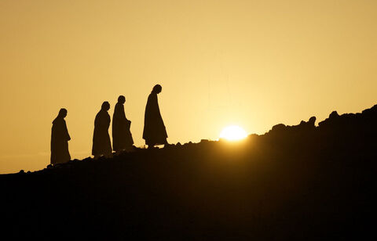
Faith Rewarded: Mark 9:2-13
2 And after six days Jesus taketh with him Peter, and James, and John,
and leadeth them up into an high mountain apart by themselves: and he was transfigured before them.

Slide 34
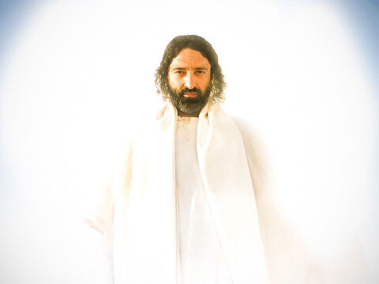
Faith Rewarded: Mark 9:3-13
3 And his raiment became shining, exceeding white as snow;
so as no fuller on earth can white them.

Slide 35
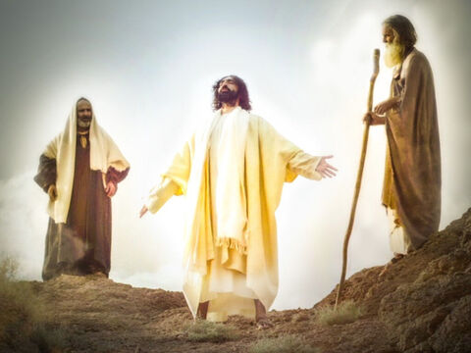
Faith Rewarded: Mark 9:4-13
4 And there appeared unto them Elias with Moses:
and they were talking with Jesus.

Slide 36
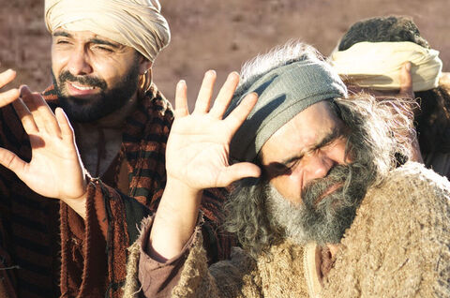
Faith Rewarded: Mark 9:5-13
5 And Peter answered and said to Jesus, Master, it is good for us to be here:
and let us make three tabernacles; one for thee, and one for Moses, and one for Elias.

Slide 37
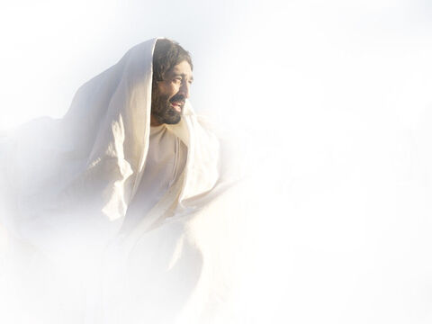
Faith Rewarded: Mark 9:6-13
6 For he wist not what to say; for they were sore afraid.
7 And there was a cloud that overshadowed them: and a voice came out of the cloud, saying, This is my beloved Son: hear him.

Slide 38
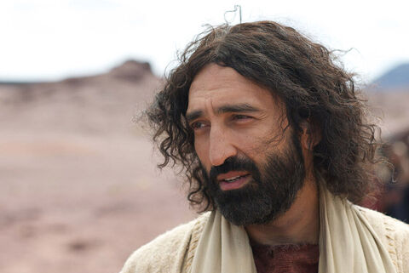
Faith Rewarded: Mark 9:8-13
8 And suddenly, when they had looked round about,
they saw no man any more, save Jesus only with themselves.

Slide 39

Faith Rewarded: Mark 9:9-13
9 And as they came down from the mountain, he charged them
that they should tell no man what things they had seen, till the Son of man were risen from the dead.

Slide 40
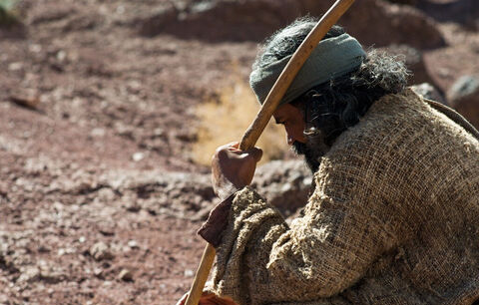
Faith Rewarded: Mark 9:10-13
10 And they kept that saying with themselves,
questioning one with another what the rising from the dead should mean.

Slide 41
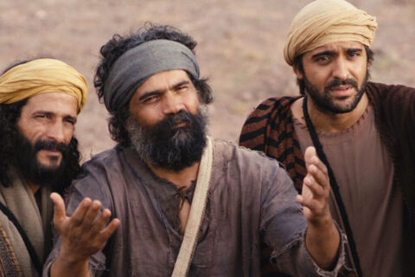
Faith Rewarded: Mark 9:11-13
11 And they asked him, saying, Why say the scribes that Elias must first come?
12 And he answered and told them, Elias verily cometh first, and restoreth all things; and how it is written of the Son of man, that he must suffer many things, and be set at nought.

Slide 42
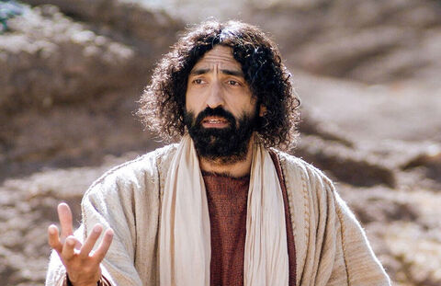
Faith Rewarded: Mark 9:13
13 But I say unto you, That Elias is indeed come,
and they have done unto him whatsoever they listed, as it is written of him.

Slide 43
“Through being overcome with sleep, the disciples heard little of what passed between Christ and the heavenly messengers. Failing to watch and pray, they had not received that which God desired to give them,—a knowledge of the sufferings of Christ, and the glory that should follow.”
The Desire of Ages p.425

Slide 44
“They lost the blessing that might have been theirs through sharing His self-sacrifice. Slow of heart to believe were these disciples, little appreciative of the treasure with which Heaven sought to enrich them.”
The Desire of Ages p.425

Slide 45
“Yet they received great light. They were assured that all heaven knew of the sin of the Jewish nation in rejecting Christ. They were given a clearer insight into the work of the Redeemer. They saw with their eyes and heard with their ears things that were beyond the comprehension of man.”
The Desire of Ages p.425

Slide 46
“They were “eyewitnesses of His majesty,” and they realized that Jesus was indeed the Messiah, to whom patriarchs and prophets had witnessed, and that He was recognized as such by the heavenly universe. “
The Desire of Ages p.425

Slide 47
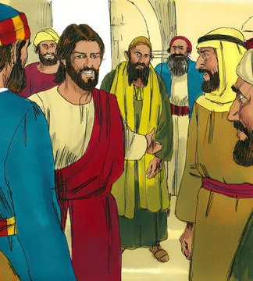
Help Mine Unbelief
Mark 9:14-30
14 And when he came to his disciples, he saw a great multitude about them, and the scribes questioning with them.
15 And straightway all the people, when they beheld him, were greatly amazed, and running to him saluted him.

Slide 48
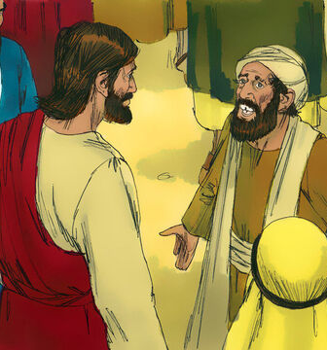
Help Mine Unbelief
Mark 9:16-30
16 And he asked the scribes, What question ye with them?
17 And one of the multitude answered and said, Master, I have brought unto thee my son, which hath a dumb spirit;

Slide 49
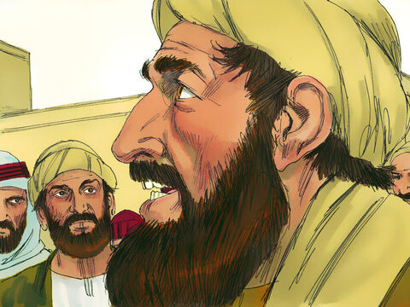
Help Mine Unbelief
Mark 9:18-30
18 And wheresoever he taketh him, he teareth him: and he foameth, and gnasheth with his teeth, and pineth away: and I spake to thy disciples that they should cast him out; and they could not.

Slide 50
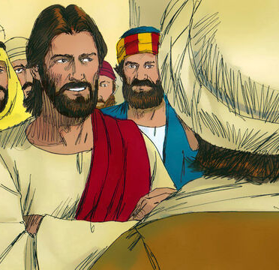
Help Mine Unbelief
Mark 9:19-30
19 He answereth him, and saith, O faithless generation, how long shall I be with you? how long shall I suffer you? bring him unto me.

Slide 51
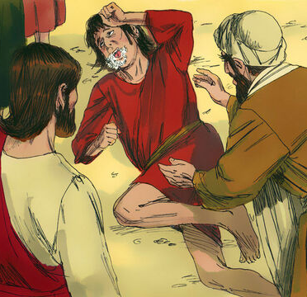
Help Mine Unbelief
Mark 9:20-30
20 And they brought him unto him: and when he saw him, straightway the spirit tare him; and he fell on the ground, and wallowed foaming.

Slide 52
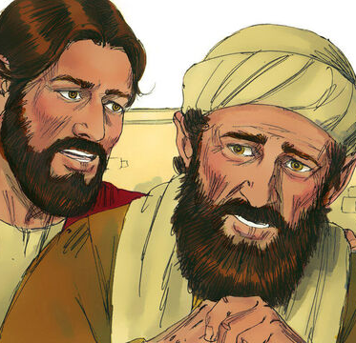
Help Mine Unbelief
Mark 9:21-30
21 And he asked his father, How long is it ago since this came unto him? And he said, Of a child.

Slide 53
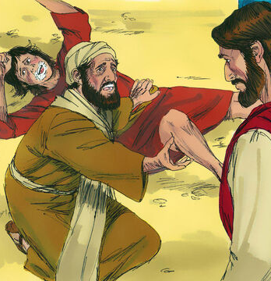
Help Mine Unbelief
Mark 9:22-30
22 And ofttimes it hath cast him into the fire, and into the waters, to destroy him: but if thou canst do any thing, have compassion on us, and help us.

Slide 54
Help Mine Unbelief
Mark 9:23-30
23 Jesus said unto him, If thou canst believe, all things are possible to him that believeth.
24 And straightway the father of the child cried out, and said with tears, Lord, I believe; help thou mine unbelief.

Slide 55
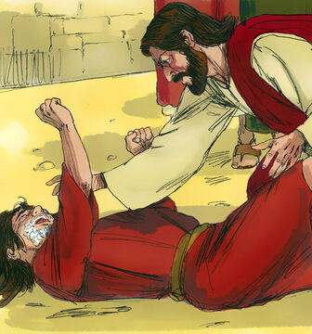
Help Mine Unbelief
Mark 9:25-30
25 When Jesus saw that the people came running together, he rebuked the foul spirit, saying unto him, Thou dumb and deaf spirit, I charge thee, come out of him, and enter no more into him.

Slide 56
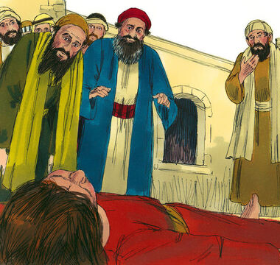
Help Mine Unbelief
Mark 9:26-30
26 And the spirit cried, and rent him sore, and came out of him: and he was as one dead; insomuch that many said, He is dead.

Slide 57
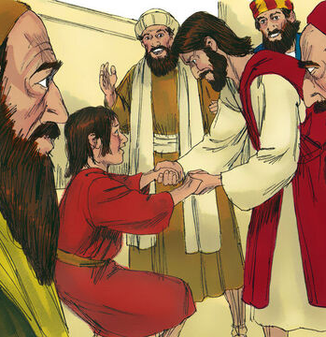
Help Mine Unbelief
Mark 9:27-30
27 But Jesus took him by the hand, and lifted him up; and he arose.
28 And when he was come into the house, his disciples asked him privately, Why could not we cast him out?

Slide 58
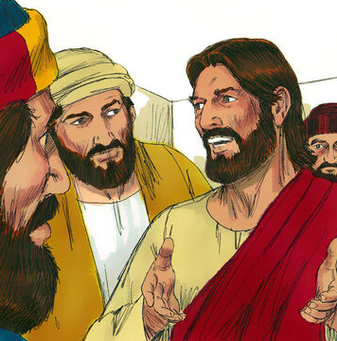
Help Mine Unbelief
Mark 9:29-30
29 And he said unto them, This kind can come forth by nothing, but by prayer and fasting.
30 And they departed thence, and passed through Galilee; and he would not that any man should know it.

Slide 59
“The words of Christ pointing to His death had brought sadness and doubt. And the selection of the three disciples to accompany Jesus to the mountain had excited the jealousy of the nine.”
The Desire of Ages p.431

Slide 60
“Instead of strengthening their faith by prayer and meditation on the words of Christ, they had been dwelling on their discouragements and personal grievances. In this state of darkness they had undertaken the conflict with Satan.”
The Desire of Ages p.431

Slide 61
“In order to succeed in such a conflict they must come to the work in a different spirit. Their faith must be strengthened by fervent prayer and fasting, and humiliation of heart. They must be emptied of self, and be filled with the Spirit and power of God.”
The Desire of Ages p.431

Slide 62
“Earnest, persevering supplication to God in faith—faith that leads to entire dependence upon God, and unreserved consecration to His work—can alone avail to bring men the Holy Spirit's aid in the battle against principalities and powers, the rulers of the darkness of this world, and wicked spirits in high places.”
The Desire of Ages p.431

Slide 63
“If ye have faith as a grain of mustard seed,” said Jesus, “ye shall say unto this mountain, Remove hence to yonder place; and it shall remove.” Though the grain of mustard seed is so small, it contains that same mysterious life principle which produces growth in the loftiest tree.”
The Desire of Ages p.431

Slide 64
“When the mustard seed is cast into the ground, the tiny germ lays hold of every element that God has provided for its nutriment, and it speedily develops a sturdy growth. If you have faith like this, you will lay hold upon God's word, and upon all the helpful agencies He has appointed.”
The Desire of Ages p.431

Slide 65
“Thus your faith will strengthen, and will bring to your aid the power of heaven. The obstacles that are piled by Satan across your path, though apparently as insurmountable as the eternal hills, shall disappear before the demand of faith. “Nothing shall be impossible unto you.”
The Desire of Ages p.431

Slide 66
Thank you!
Happy Sabbath!!

